Slide 1
PROJECT 01 – Depreciation Method
Introduction
Key Findings
Actionable
Approaches
Insight
Conclusions

Slide 2
Introduction
Depreciation value – systematic allocation of cost as pre life span
2 Type of Depreciation-
1) Straight Line Method
2) Diminishing Method

Slide 3
Key Findings
Asset Cost – Initial cost of asset
Additional Cost – Transportation, Installation and set Up cost
Asset Price – Asset Cost + Additional Cost
Scrap Value – Estimated Residual or Salvage Value of the asset at end of its useful life
Estimated Life span - The expected number of years over which the asset will be depreciated.
Depreciation/Year as per Straight Line Method: The amount of depreciation allocated to each year of the asset’s
useful life, calculated as (Asset Price - Scrap Value) / Estimated Life Span.
Depreciation Percentage: The annual depreciation rate, calculated as
(Depreciation/Year as per Straight Line Method) / Asset Price.
Total Depreciation For Its Life Span: The total depreciation expense over the asset's entire useful life,
calculated as (Depreciation/Year as per Straight Line Method) * Estimated Life Span.
Depreciated Book Value After Its Life Span: The value of the asset after it has been fully depreciated,
equal to the scrap value.
Balance Amount: Any remaining balance after fully depreciating the asset, which should ideally be zero.

Slide 4
Key Findings
Depreciation/Year as per Straight Line Method – (Asset Price - Scrap Value) / Estimated Life Span
Depreciation Percentage – (Depreciation/Year as per Straight Line Method) / Asset Price
Total Depreciation For Its Life Span - (Depreciation/Year as per Straight Line Method) * Estimated Life Span.

Slide 5
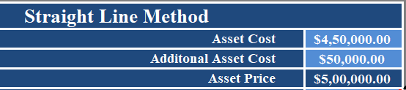

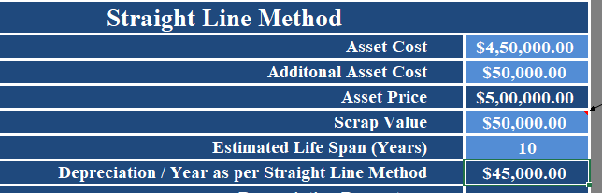
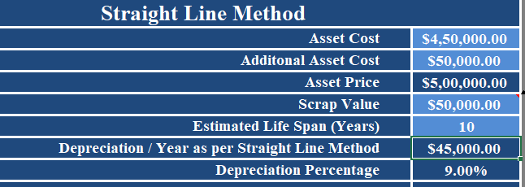
Actionable & Approach
straight line method:
Calculate the Asset Price
Ans: “Asset Cost + Additional cost”
What's is the depreciation as per straight line method
What is the depreciation percentage for the straight-line method?

Slide 6
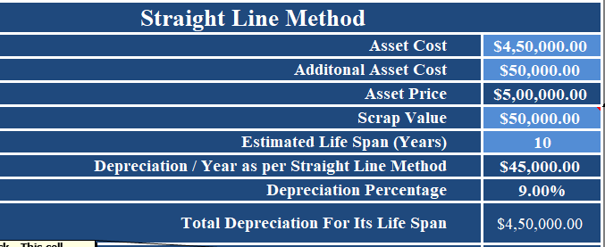

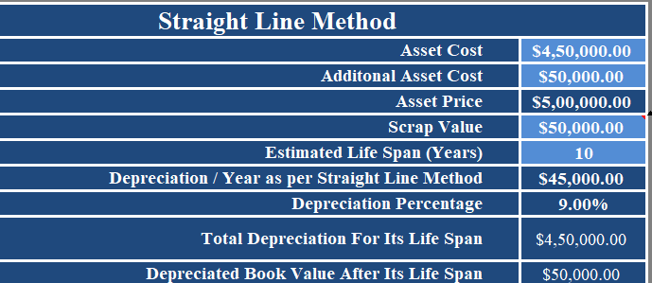

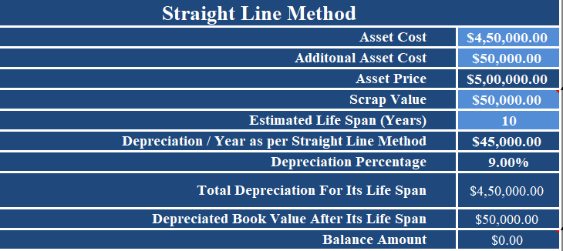

straight line method:
What is the total depreciation for its life span
Find the depreciated book value after its life span
What is the Balance amount

Slide 7
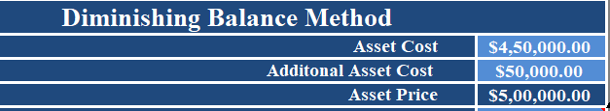

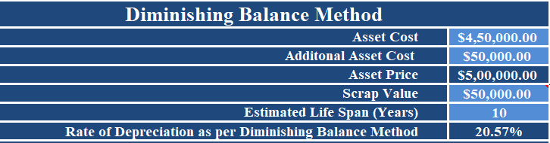

Diminishing Balance Method:
Calculate the Asset Price
Find the rate of depreciation as per diminishing balance method

Slide 8
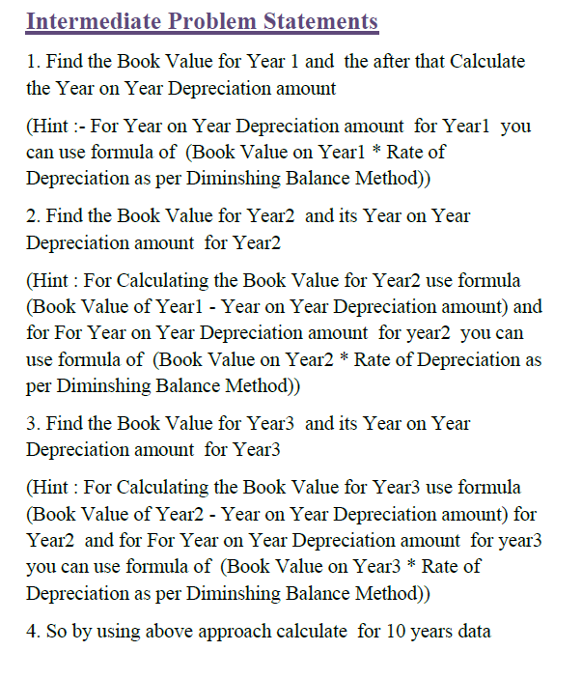
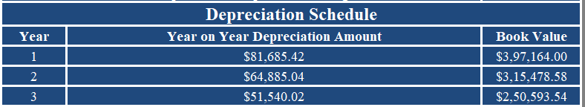

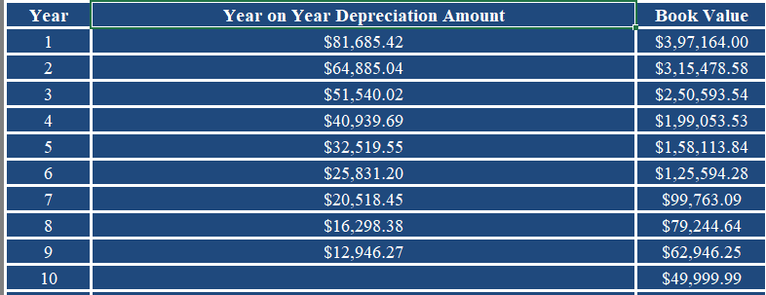
Book value for 1st Year -
((Asset Price * Rate of Depreciation as per Diminishing Balance Method) - Asset Price)
Year on Year Depreciation Amount:
Year on Year Depreciation Amount for 10 year :

Slide 9
Calculate the annual depreciation amount using the straight-line method for the given asset.
Calculate the total depreciation for the asset's entire life span using the straight-line method.
What is the depreciated book value of the asset after its life span using the straight-line method?
Calculate the rate of depreciation per year as per the diminishing balance method.
What is the depreciation amount for the asset in the second year according to the diminishing balance method?
What is the book value of the asset in the fourth year using the diminishing balance method?
Calculate the total depreciation for the asset's entire life span using the diminishing balance method.
What is the book value of the asset after its life span using the diminishing balance method?
Compare the total depreciation amounts obtained from the straight-line method and the diminishing balance method.
Which method results in higher total depreciation?
In straight line Method depreciation amount obtained = 4,50,000/-
In diminishing Balance Method = 3,57,447.60 /-
Straight Line Method have higher depreciation amount.
10) Prepare a Presentation for above Analysis you made so far along with Visual Graphs representation

Slide 10
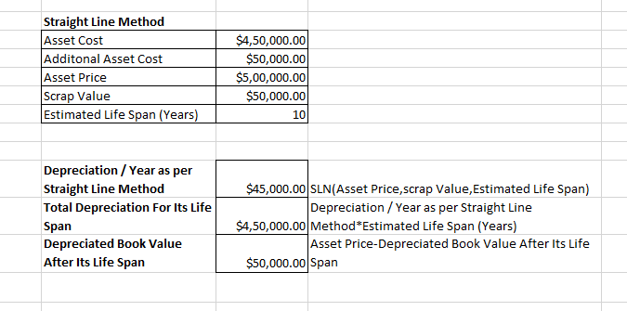
Question 1 – 3 Answers

Slide 11
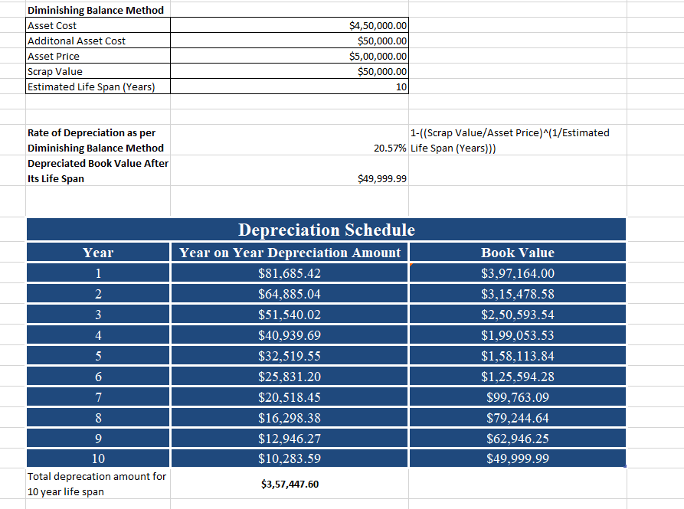
Question 4 – 8 Answers

Slide 12
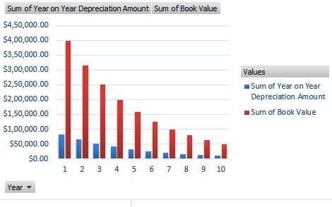
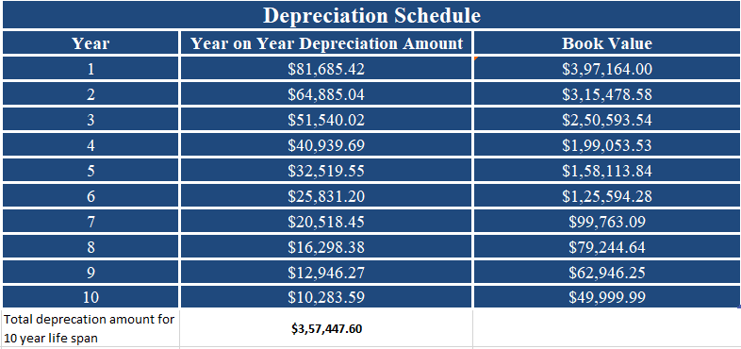
Question 10 answer
Insight

Slide 13
Conclusion
Straight Line Method used when utility and life span is consistent.
Asset value become Zero once life span over
For Eg. Vehicle, Building
Vs.
Diminishing Method used when utility value decreased rapidly not considerable with life span.
By its life span its maintenance increasing and its asset value never be zero
For Eg. Used in Oil Industry

